Slide 1
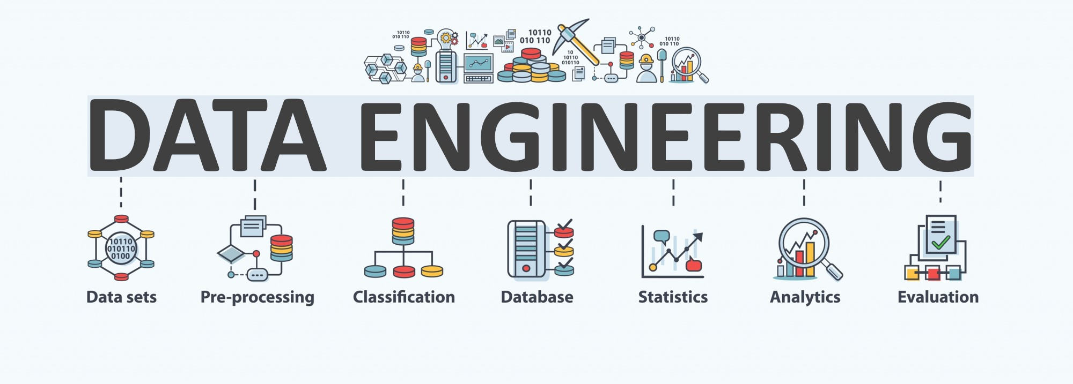

Lecture 4: Data Visualization
CS5481 Data Engineering
Instructor: Yifan Zhang

Slide 2
Outline
Introduction to Data Visualization
Conventional Visualizations
Data Visualization Skills
Tips and Tricks
Data Visualization Traps
Visualization and Dashboard Software

Slide 3
Why do we need data visualization?
The power of the unaided mind is highly overrated. The real powers come from devising external aids that enhance cognitive abilities.
Without external aids, memory, thought, and reasoning are all constrained.
But human intelligence is highly flexible and adaptive, superb at inventing procedures and objects that overcome its own limits, e.g., pencil and paper.
How have we increased memory, thought, and reasoning?
By the invention of external aids: Some assistance comes through cooperative social behavior;
some arises through exploitation of the information present in the environment; and
some comes through the development of tools of thought – cognitive artifacts – that complement abilities and strengthen mental powers.

Slide 4


This is a gap between human brain and data
Human recognition cannot directly process computerized data.
Human brains are good at visual cognition.

Slide 5
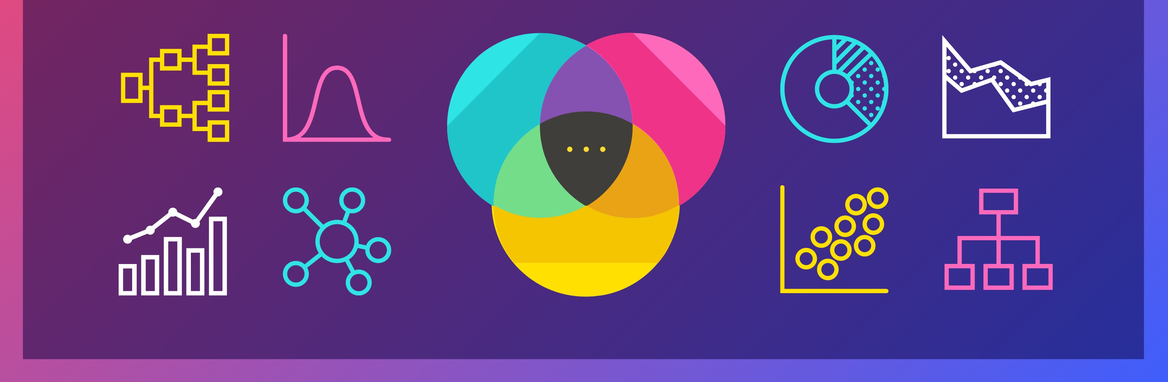
Data visualization
Data visualization is the study of visual representations of abstract data to reinforce human cognition. Its goal is to make information easy to comprehend, interpret, and retain.
The discipline of communicating information through the use of visual elements such as graphs, charts, and maps.

Slide 6

A data visualization example
Charles Minard’s map of Napoleon’s march time and time again – almost to the point of exhaustion

Slide 7
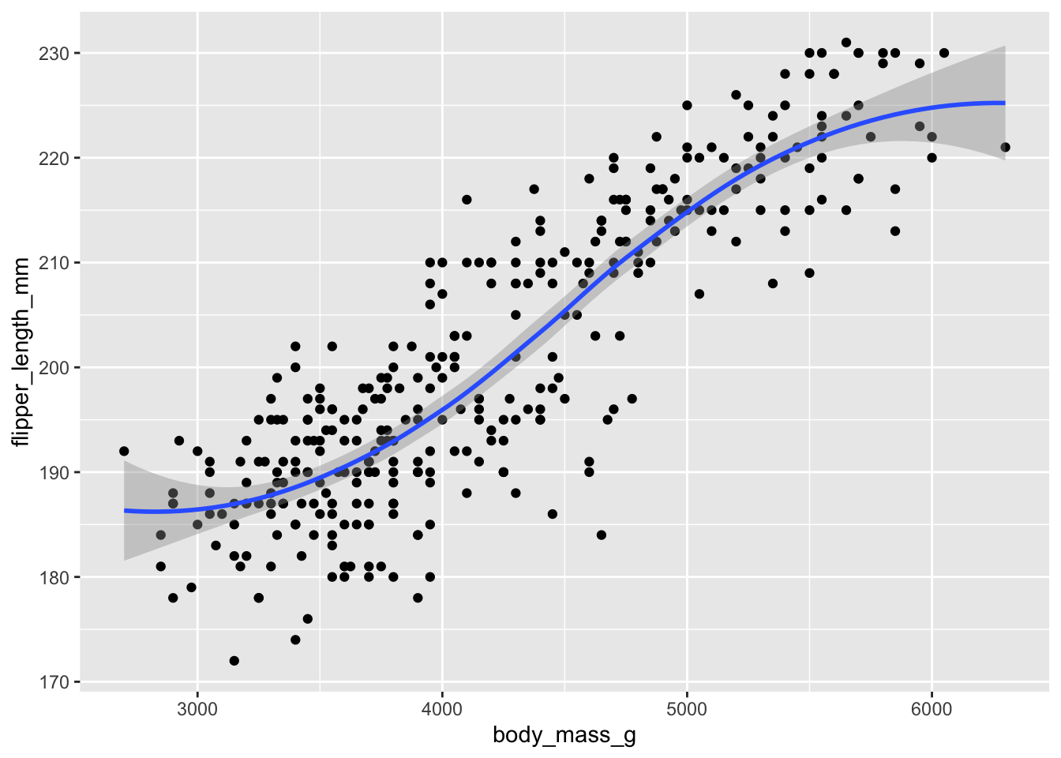
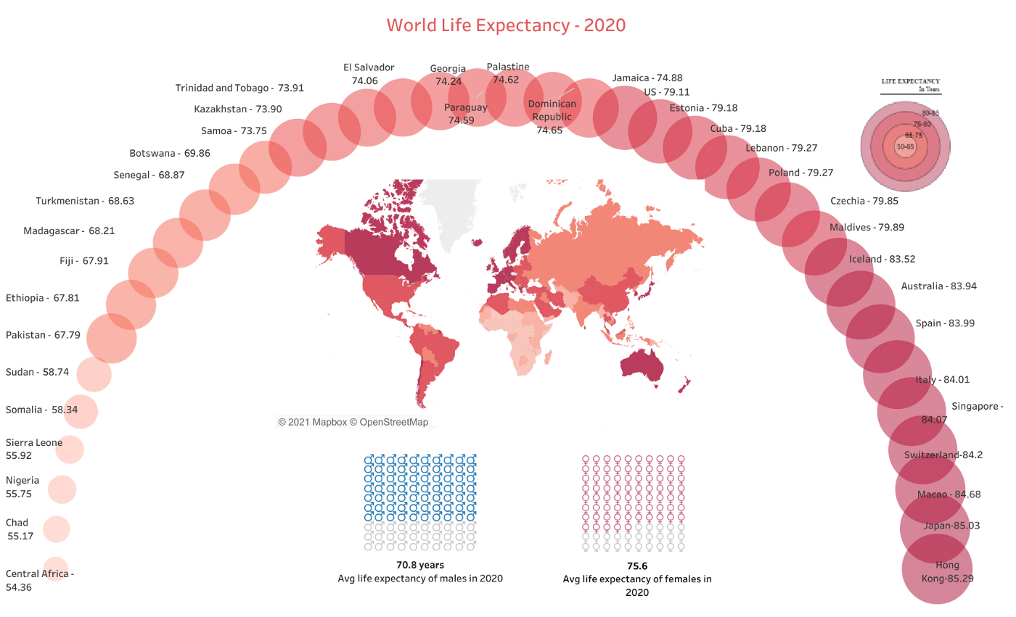
Exploratory vs. explanatory data visualization
Exploratory data visualization
Exploratory visualizations are used when you want or need to explore data to find insights. You use these types of visualizations to help better understand your underlying data.
Sharing is limited to internal teams/research groups and not published or presented to larger groups
Explanatory data visualization
Explanatory visualizations are used to communicate the results of your analyses.
Use for data storytelling/presentations
Body mass vs. flipper length of chickens

Slide 8
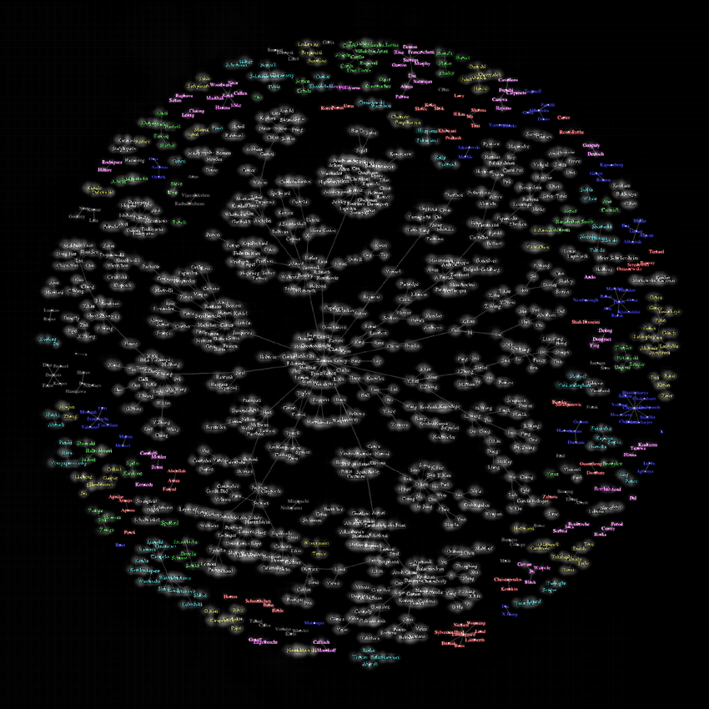
Data visualization – a combination of science and art
Science – skills
A skill to handle “the graphical display of data”, to select a good way to present, to use specific software, etc.
Art – the beauty of data
The main way complicated problems are explained to decision makers.
A good graphic tells a story. To help identify patterns in a data set and explain those patterns to a wider audience.
Everything should be made as simple as possible, but no simpler.
Ink is cheap. Electrons are even cheaper.

Slide 9
Choosing appropriate visualizations - statistics
For data visualization to be of value, choose the visualization that effectively delivers your findings to your audience.
What is the relationship that I am trying to establish?
Do I want to compare multiple values?
Do I need my audience to see the correlation between two variables?
Do I want to detect anomalies in data?

Slide 10
Choosing appropriate visualizations - audiences
You need to be able to answer this question for your audience with every dataset and information that you visualize.
What should be the key takeaway for my audience?
What does my audience need to know?
What are the questions they have?

Slide 11
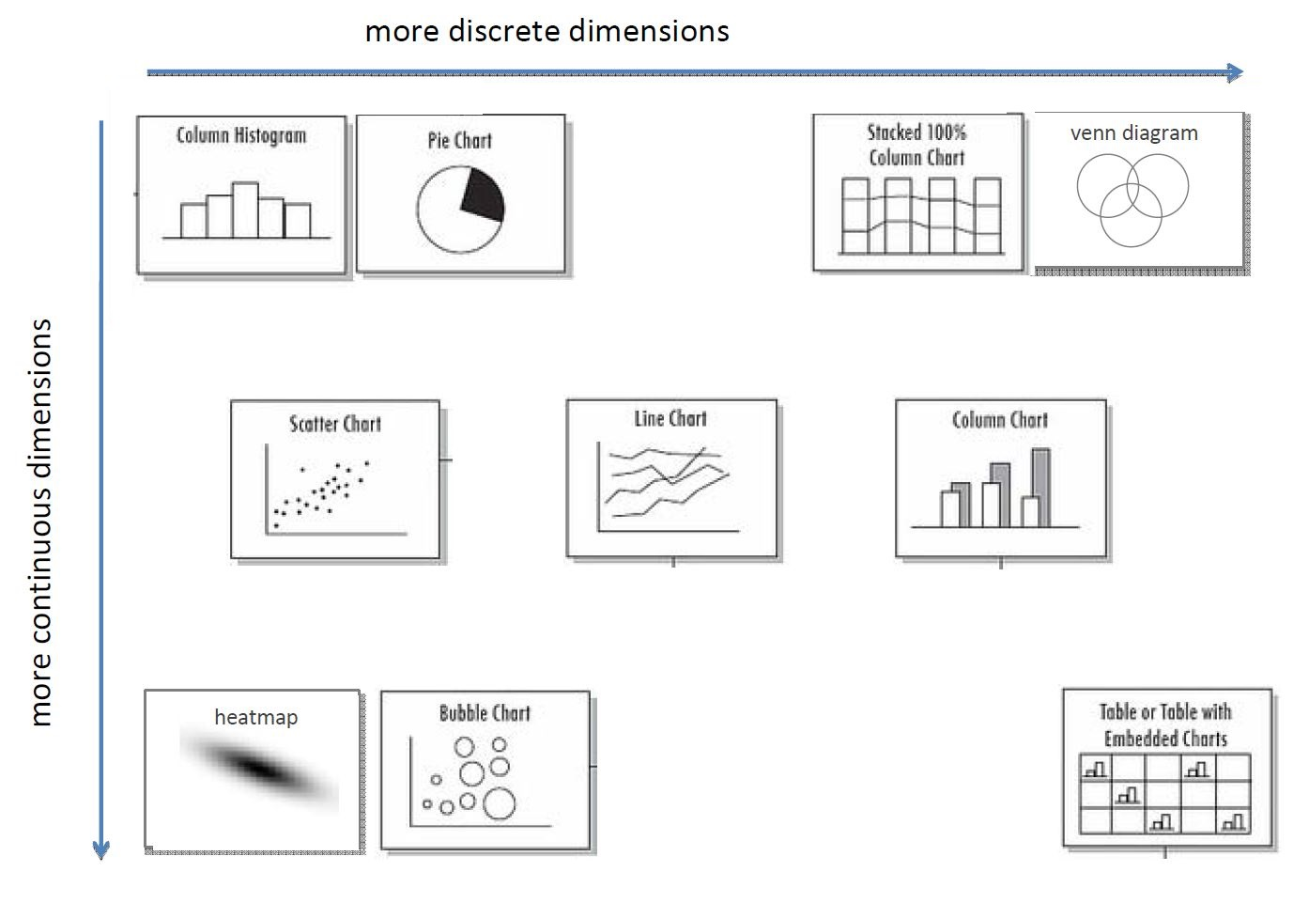
Conventional visualizations (1)

Slide 12
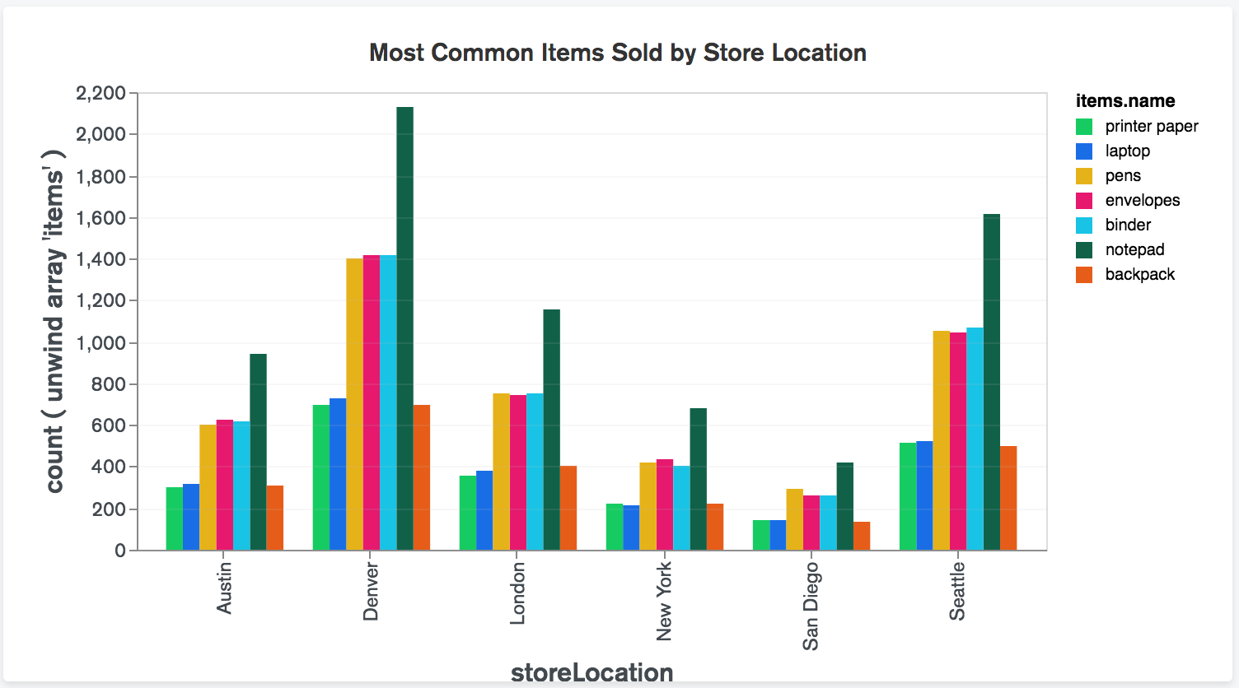
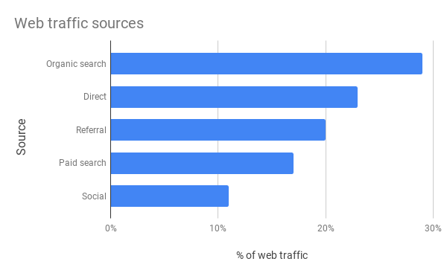
Visualizations – charts
Bar chart
Great for comparing related data sets or parts of a whole.
Column chart
Compare values side-by-side. You can use them quite effectively to show change over time

Slide 13
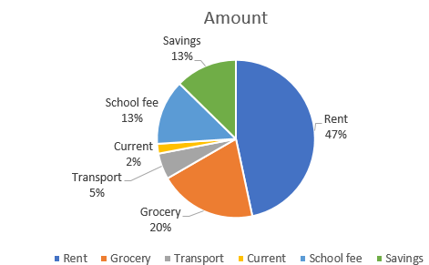
Visualizations – pie charts
Pie chart
Show the breakdown of an entity into its sub-parts and the proportion of the sub-parts in relation to one another.
Each portion of the pie represents a static value of category, and the sum of all categories is equal to hundred percent.

Slide 14
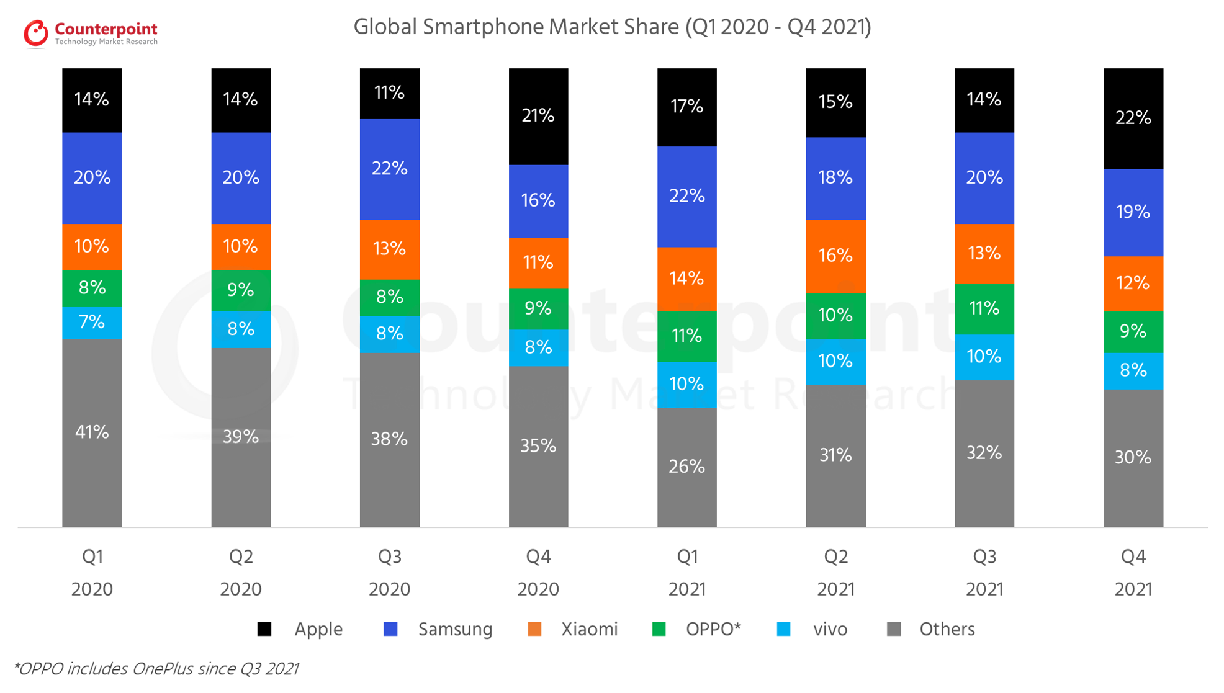
Visualizations – stacked bar graphs
Stacked bar graph
Wholes split into parts.
Easy to compare – often better than pie chart.
Can have multiple discrete dimensions.

Slide 15
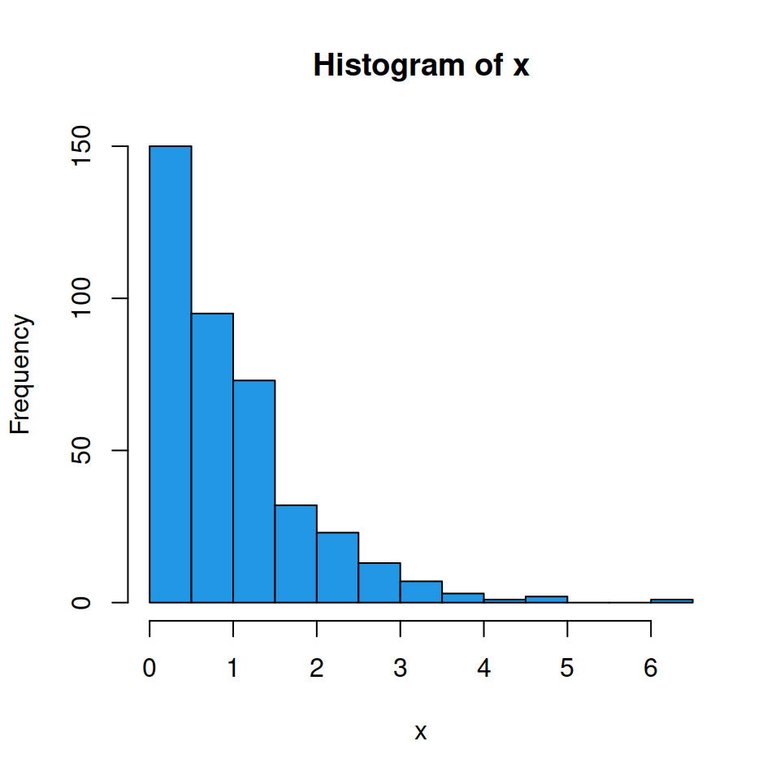
Visualizations – histograms
Histogram
Important first way of looking at your data.
One dimensional
Shows shape by binning a continuous distribution
Frequencies of search queries

Slide 16
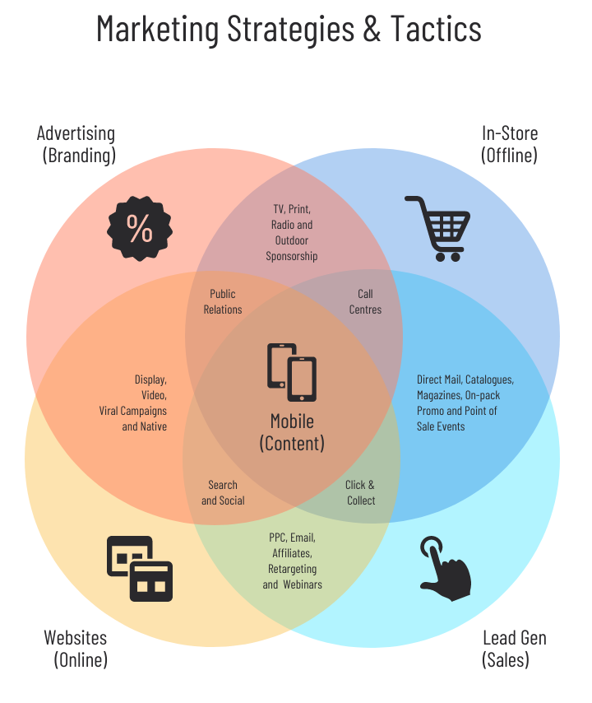
Visualizations – venn diagrams
Venn diagram
Shows overlap between discrete groups.
Sometimes the only way to display overlapping sets.
Unintuitive – no “popout”

Slide 17
Conventional visualizations (2)

Slide 18
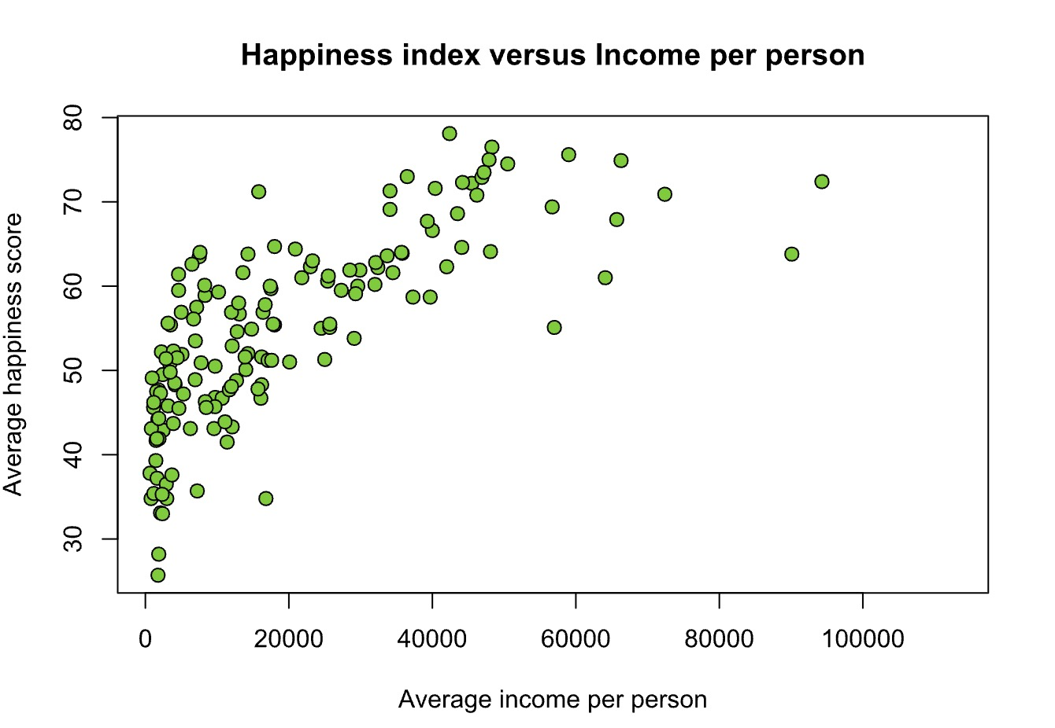
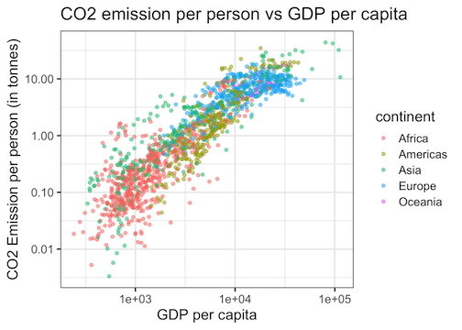
Visualizations – scatter plots
Scatter plot
Relationship between observations on two continuous dimensions
Can show multiple groups
Can show trend lines etc.
Uninformative with too much data

Slide 19
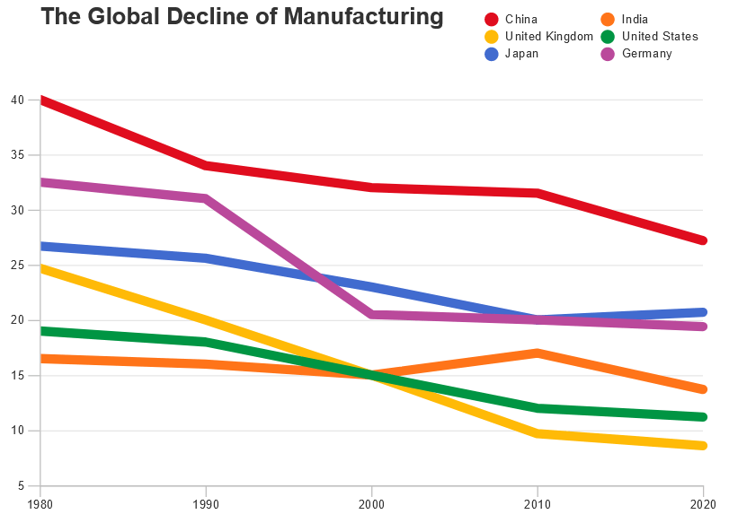
Visualizations – line graphs
Line Graph
Also ubiquitous.
Good for showing one variable as continuous even though you have discrete measures.
Can compare several discrete groups.

Slide 20
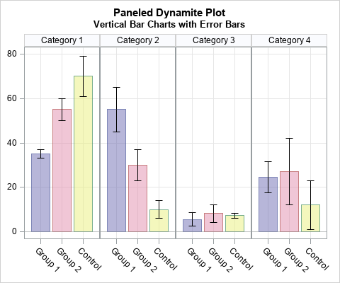
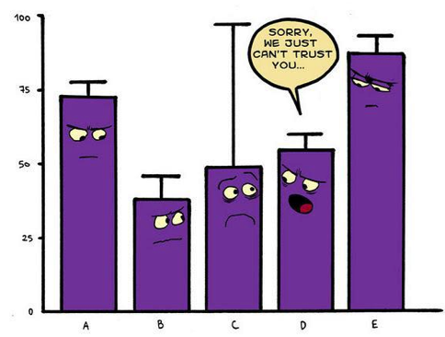
Visualizations – dynamite plots
Dynamite Plot
Can be used for lots of discrete grouping factors.
Natural semantics of grouping
Conceals data.

Slide 21
Conventional visualizations (3)

Slide 22
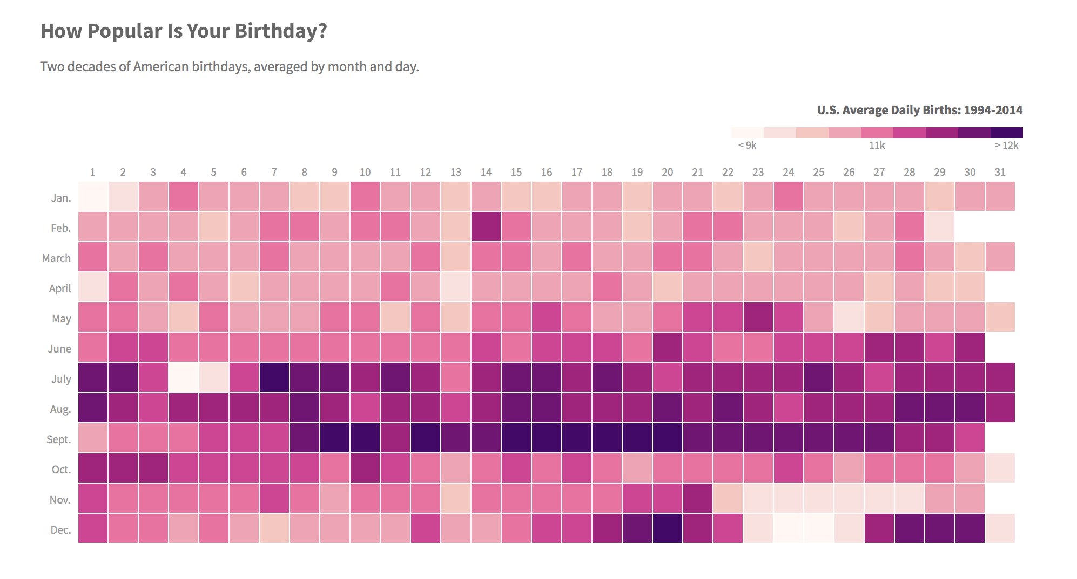
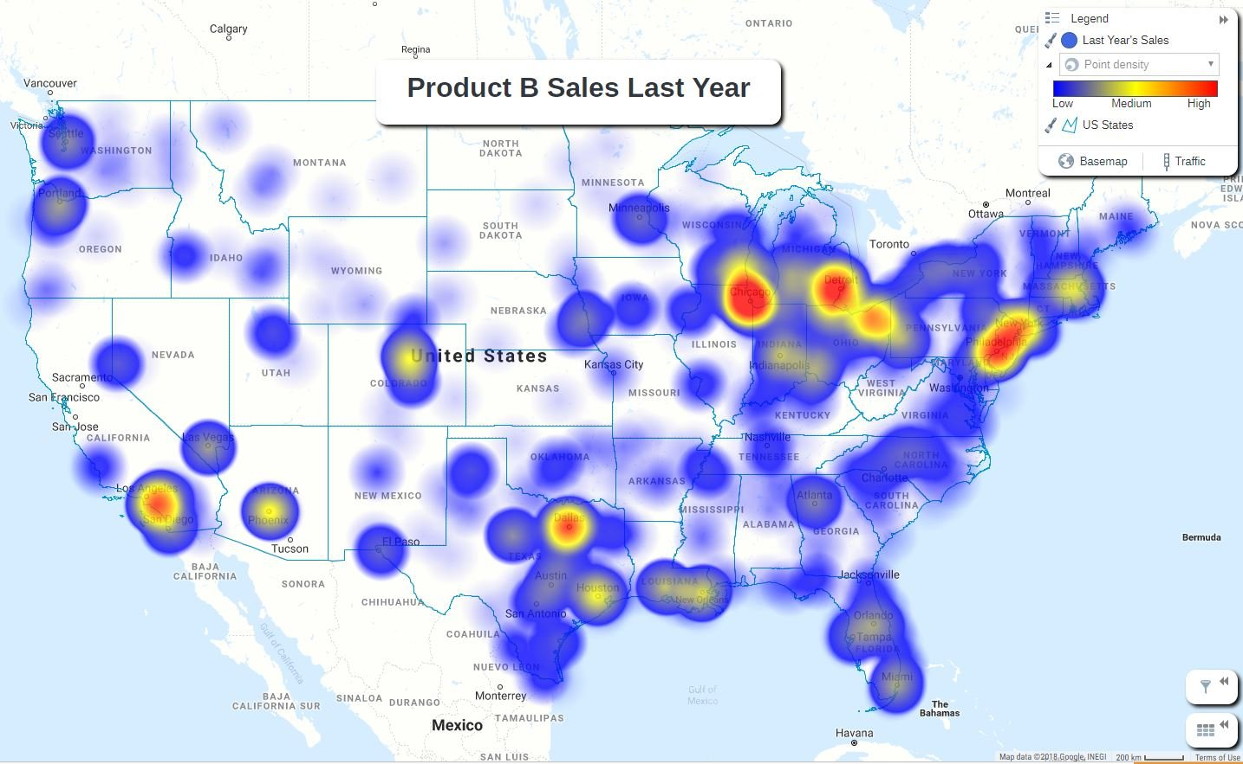
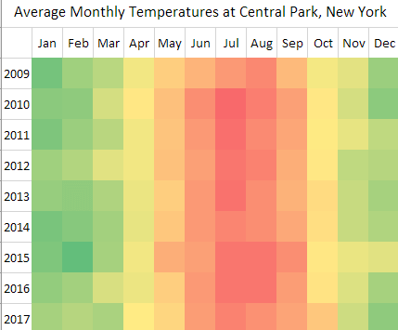
Visualizations – heat maps
Heat map
Works very well when there are natural semantics.
Color mapping can be problematic – grayscale usually fine.
Can be unintuitive.

Slide 23
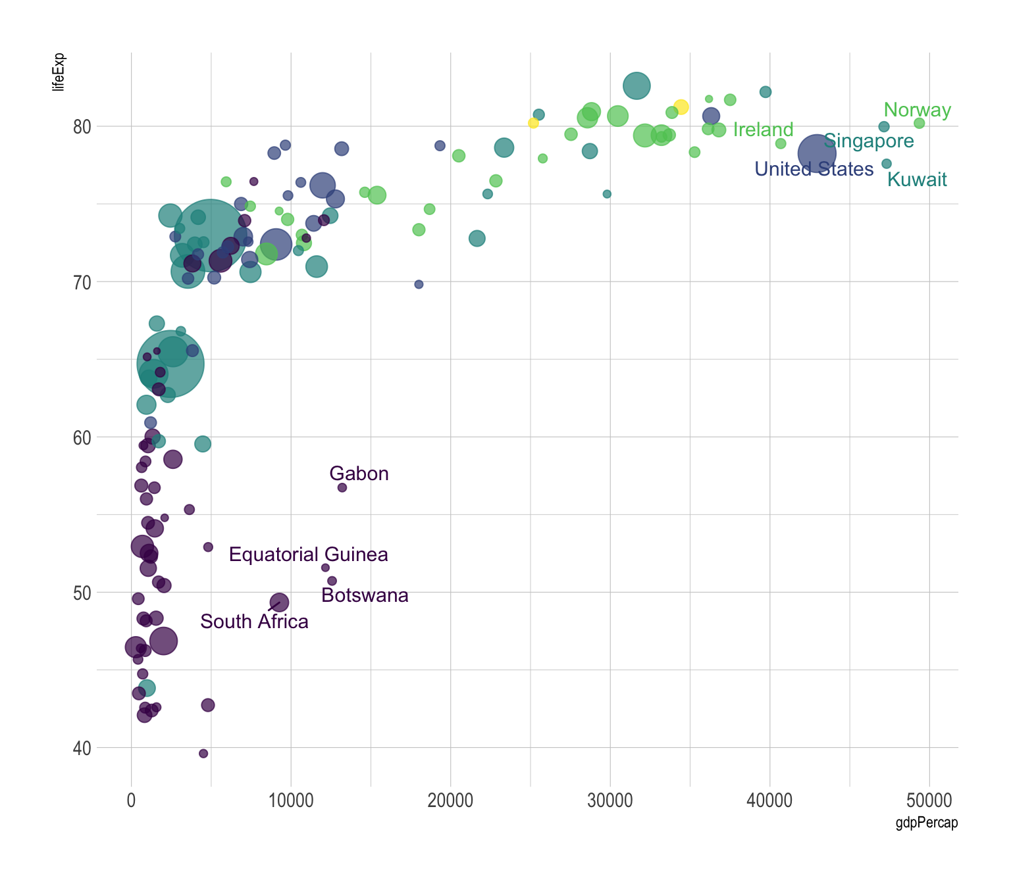
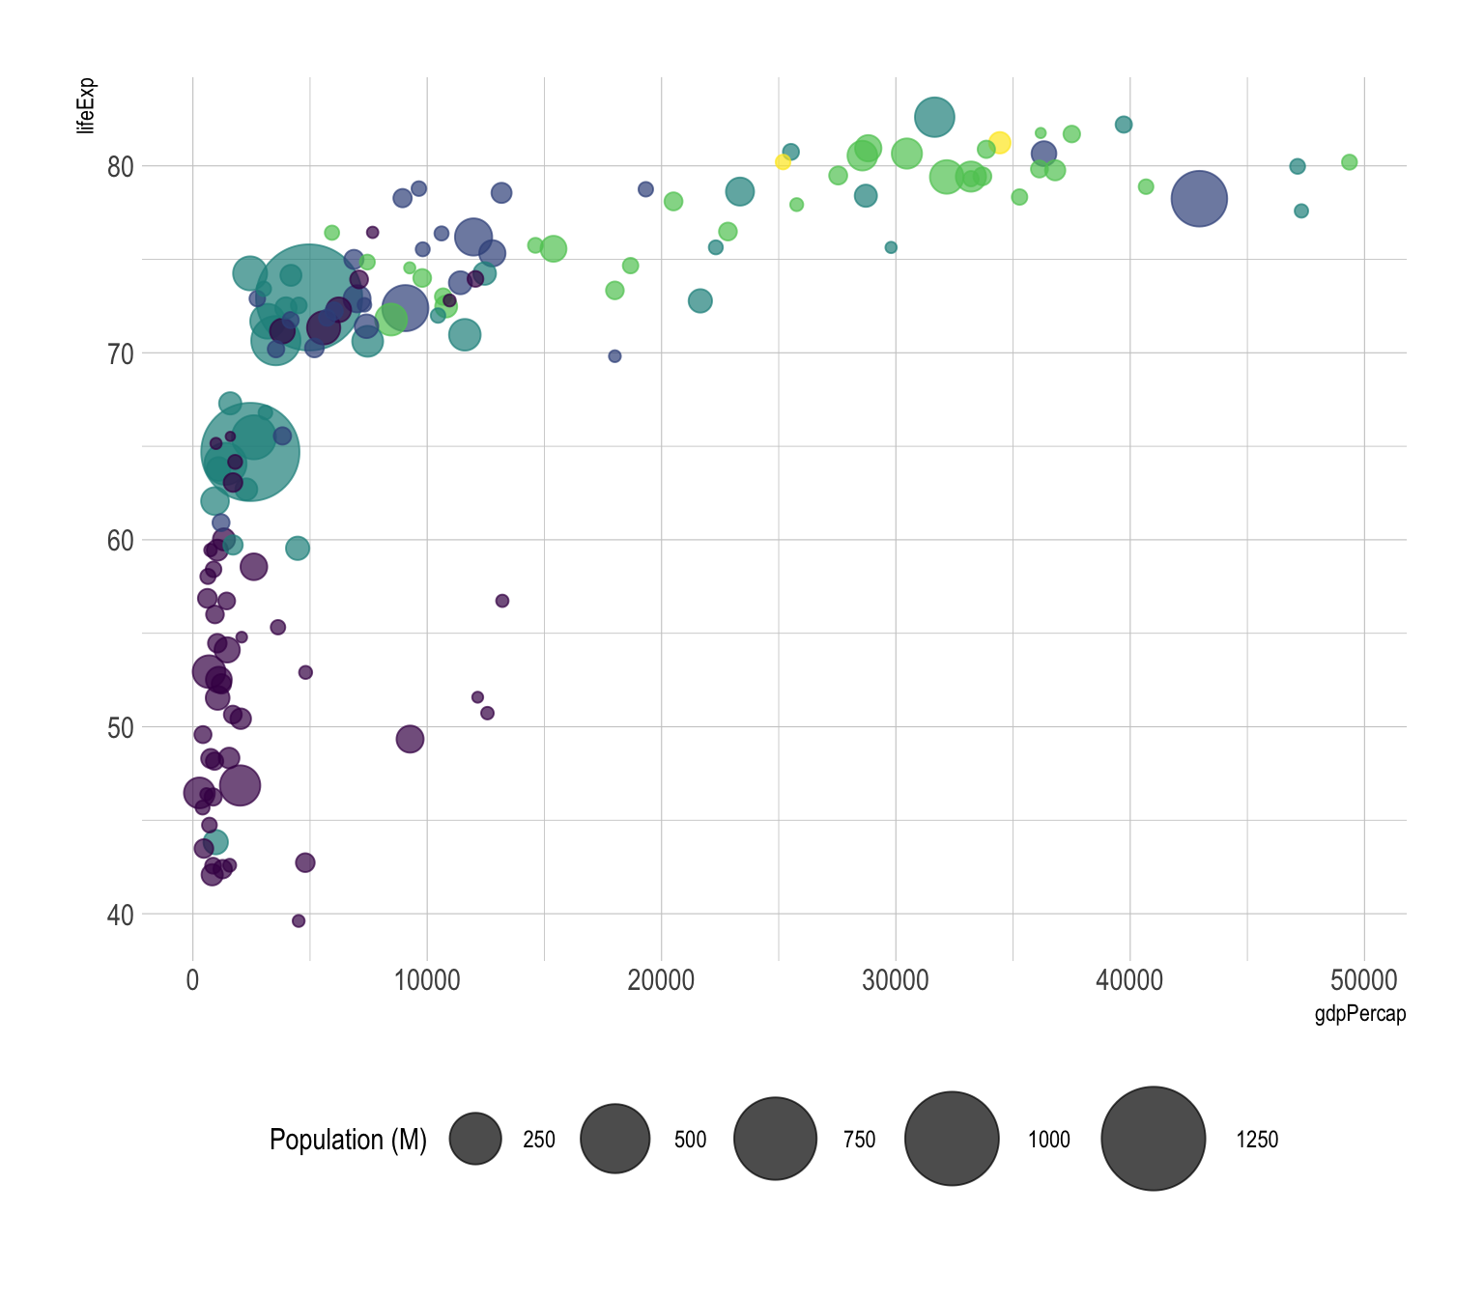
Visualizations – bubble plots
Bubble plot
Can be very intuitive.
Size is not perfectly quantitative.
Different bubbles represent different countries; colors represent continents; sizes of the bubbles represent the size of population.

Slide 24
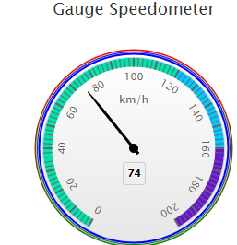
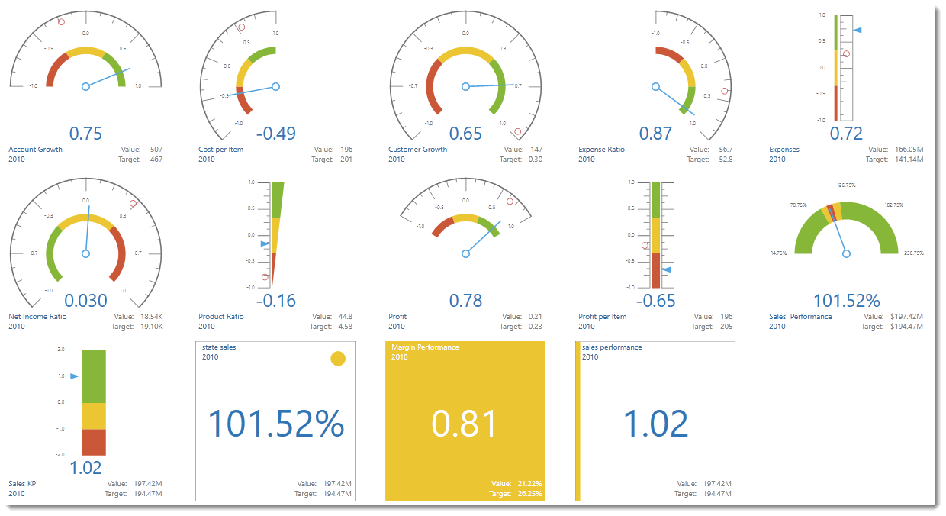
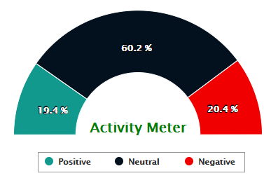
Others – gauges
Gauge
Creates a gauge that indicates its metric value along an arc.

Slide 25
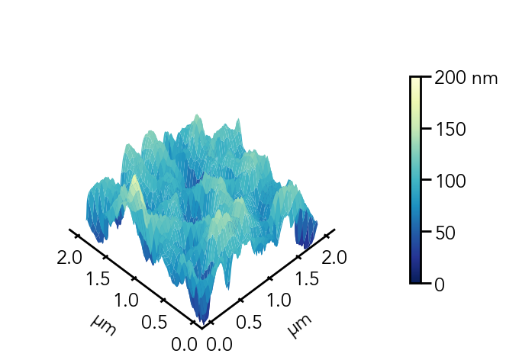
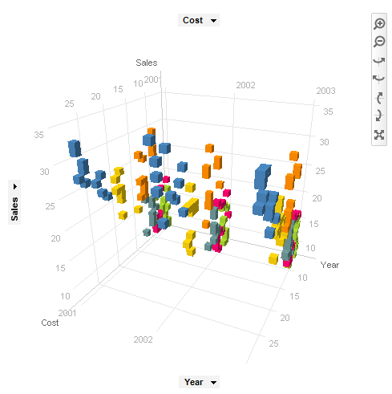
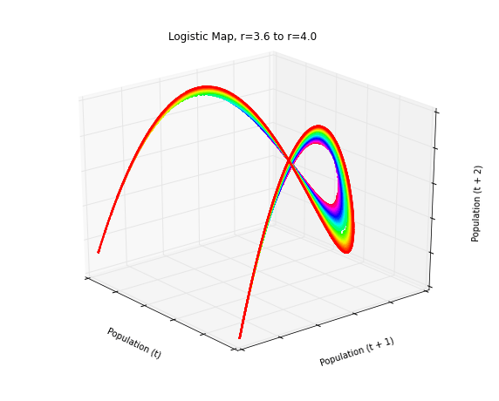
Others – 3D visualization
3D plot
3-D Dimensional data which provides the perception of depth, breadth, and height. Three-dimensional visualizations developed to provide both qualitative and quantitative information about an object.

Slide 26
Data visualization skills (1)
Find out what you want to say
This is the first and most important step in visualization preparation. You must ask yourself, “what is the purpose of this chart?”. Once we know the clear reason why the chart should exist, we will naturally be able to select the correct chart type for that reason.

Slide 27
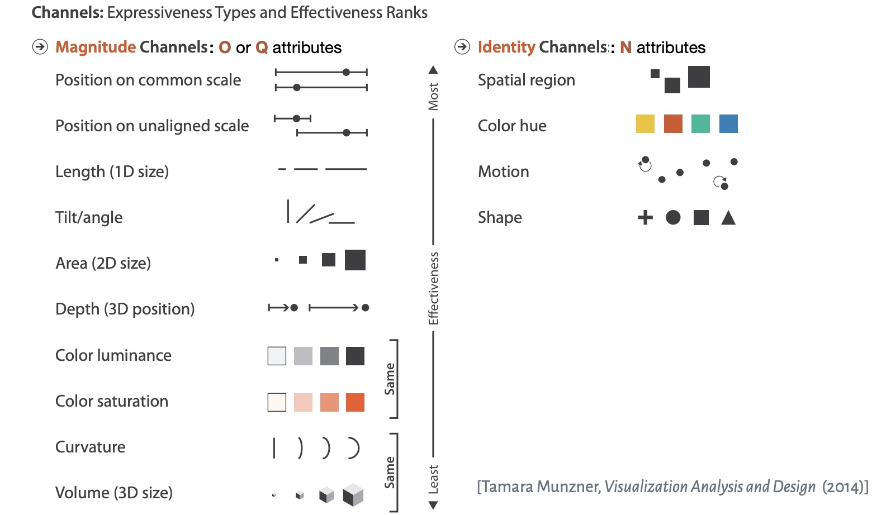
Effectiveness vs. expressiveness
Effectiveness
To effectively map data to visuals, we need a level of abstraction. Data abstraction allows us to consistently encode the same "types" of data, even if different domains use different terminology to describe it
Expressiveness
A set of facts is expressible in a visual language if the sentences (i.e. the visualizations) in the language express all the facts in the set of data, and only the facts in the data.

Slide 28
Data visualization skills (2)
There are usually 6 reasons to make a chart:
To compare
To show the distribution
To explain parts of the whole
To tell the trend over time
To find out the deviations
To understand the relationship

Slide 29

To compare
What it means?
- You want to compare one set of value(s) with another.
Examples:
- Performance of Product A vs. Product B in 5 regions.
Interview performance of various candidates.
Charts that can be used for this reason:

Slide 30

To show the distribution
What it means?
- You want to show the distribution of a set of values (to understand the outliers, normal ranges etc.)
Examples:
- Distribution of call waiting times in a call center
Charts that can be used for this reason:

Slide 31

Parts of whole
What it means?
- You want to show how various parts comprise the whole.
Examples:
Individual product sales as a percentage of whole revenue.
Browser types of customers visiting our website.
Charts that can be used for this reason:

Slide 32
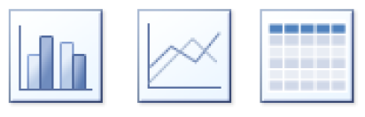
Trend over time
What it means?
- You want to understand the trend over time of some variable(s).
Examples:
Customer footfalls on the last 365 days.
Share price of MSFT in the last 100 trading sessions.
Charts that can be used for this reason:

Slide 33

To find out the deviations
What it means?
- You want to see which values deviate from the norm.
Examples:
Failures (or bugs) in the context of quality control.
Sales in various stores.
Charts that can be used for this reason:

Slide 34
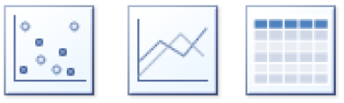
To understand the relationship
What it means?
- You want to establish (or show) relationship between 2 (or more) variables.
Examples:
Relationship between Search Phrases and Product Purchases in your website.
Relationship between in-store sales and holidays.
Charts that can be used for this reason:

Slide 35
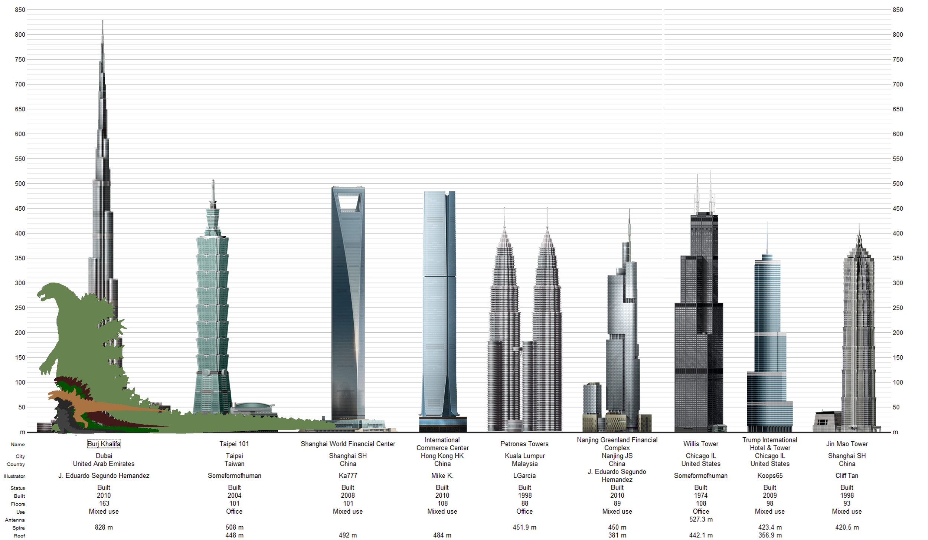
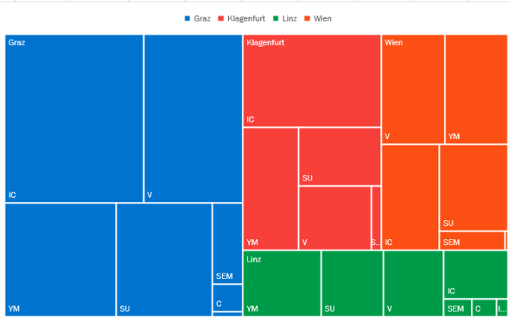
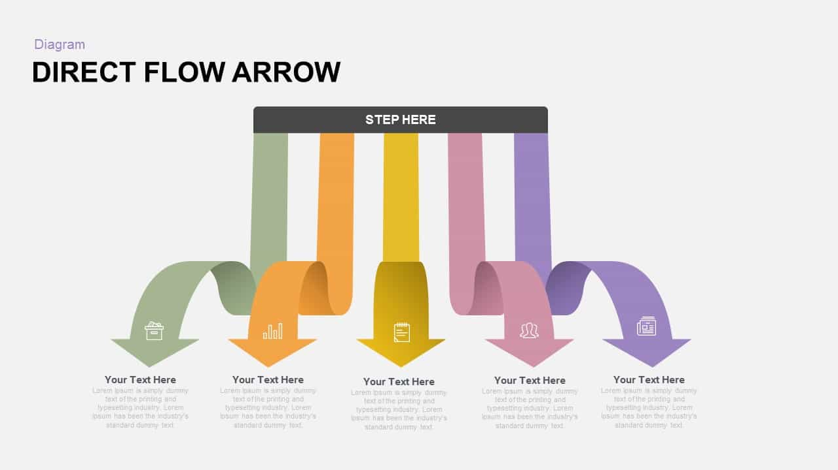
Data visualization skills
Skills
Use graph to represent number: Instead of bars and lines, use some related figures. Integrating and clear.
Comparison
2D instead of 1D: Use area instead of bars to represent data
Metaphor: Give a similar concept to tell the story
Flow: Circle, Arrow

Slide 36
Tips and Tricks
3 tricks for doing more with less
Multiple Plots
Simple, easily interpretable subplots.
Can be beautiful but overwhelming.
Hybrid Plots
A scatter plot of histograms.
Or a venn-diagram of histograms, etc.
Multiple Axes
- Plot two (or more) different things on one graph.

Slide 37
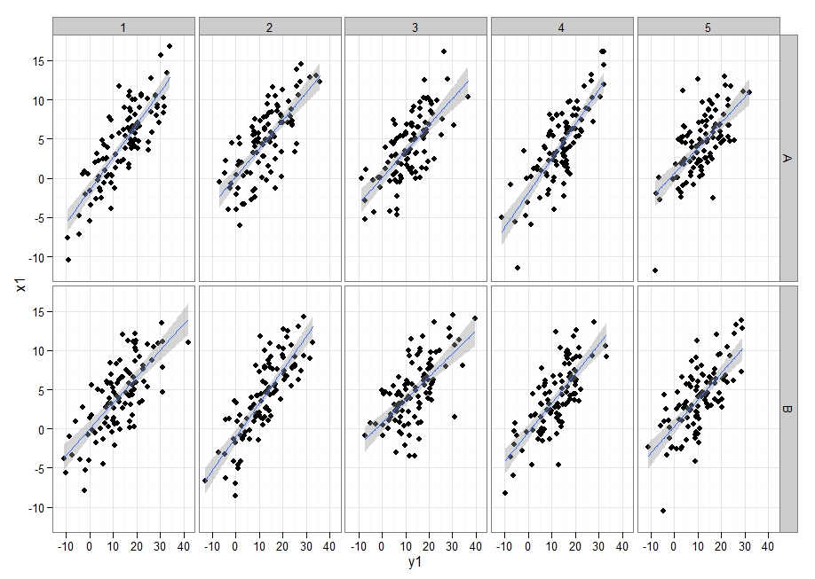
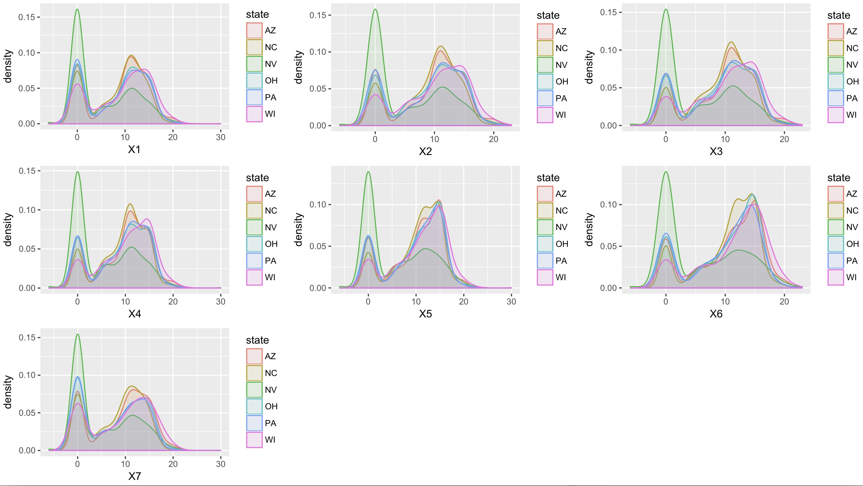
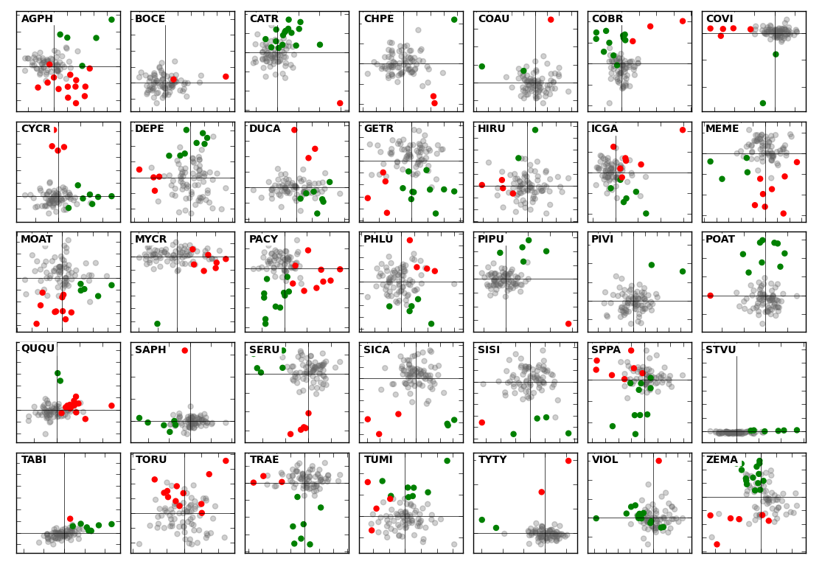
Multiple plots

Slide 38
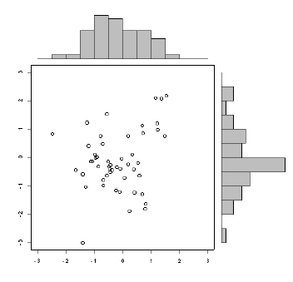
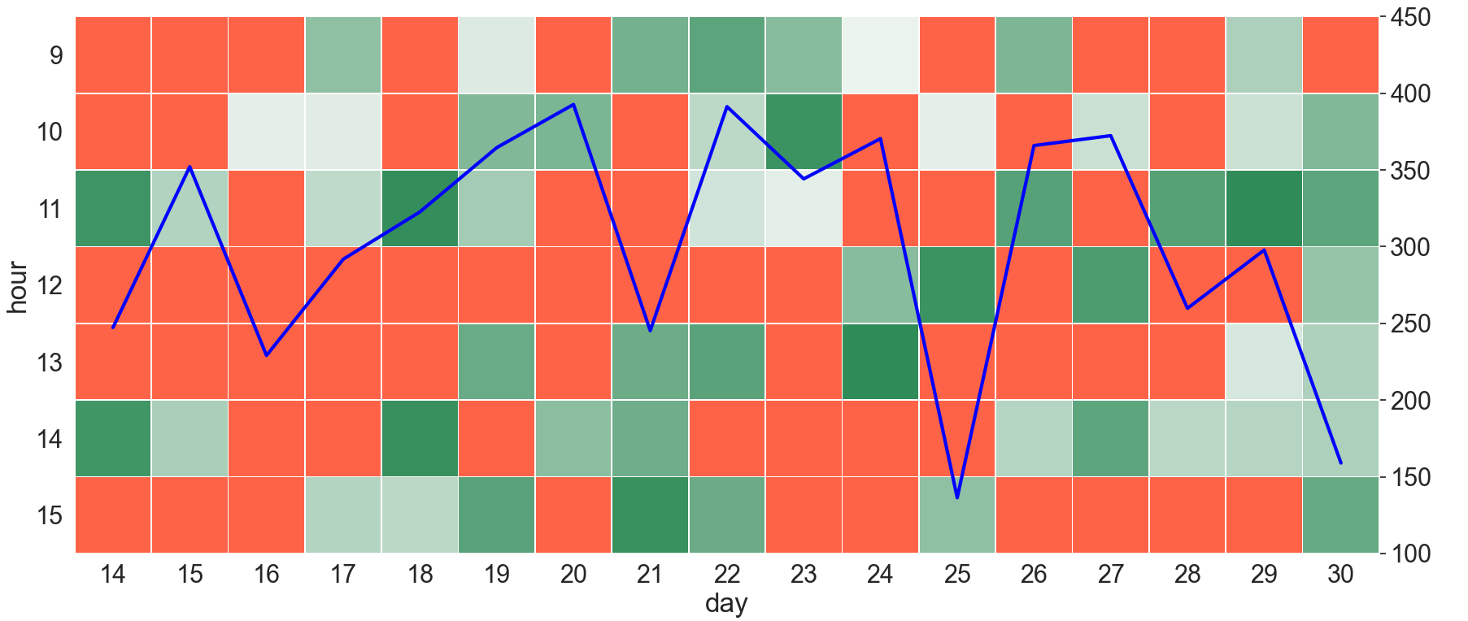
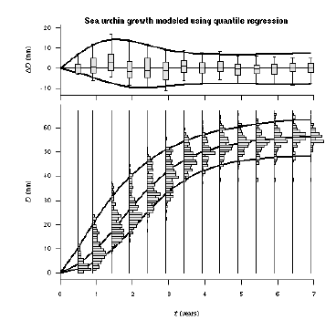
Hybrid plots

Slide 39
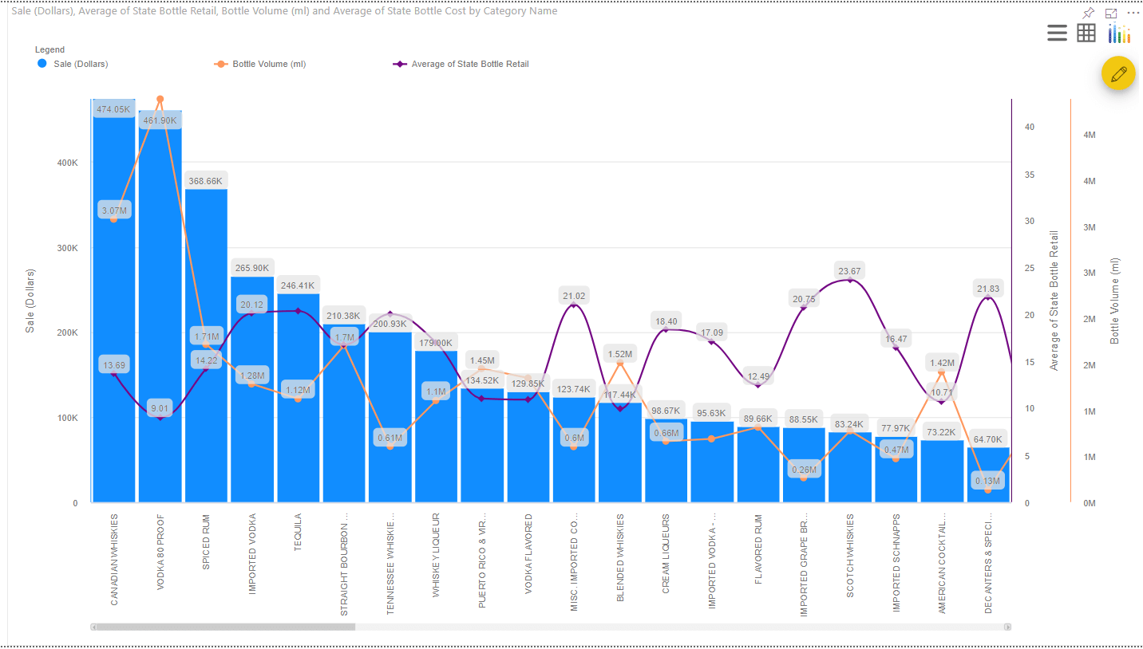
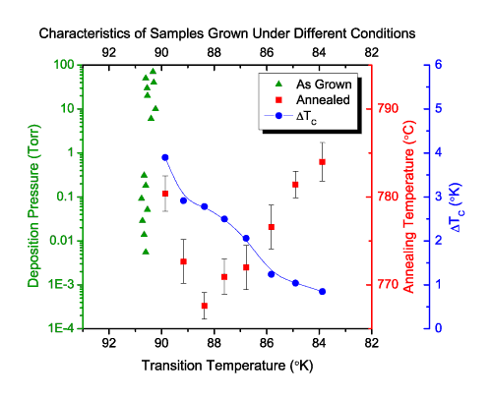
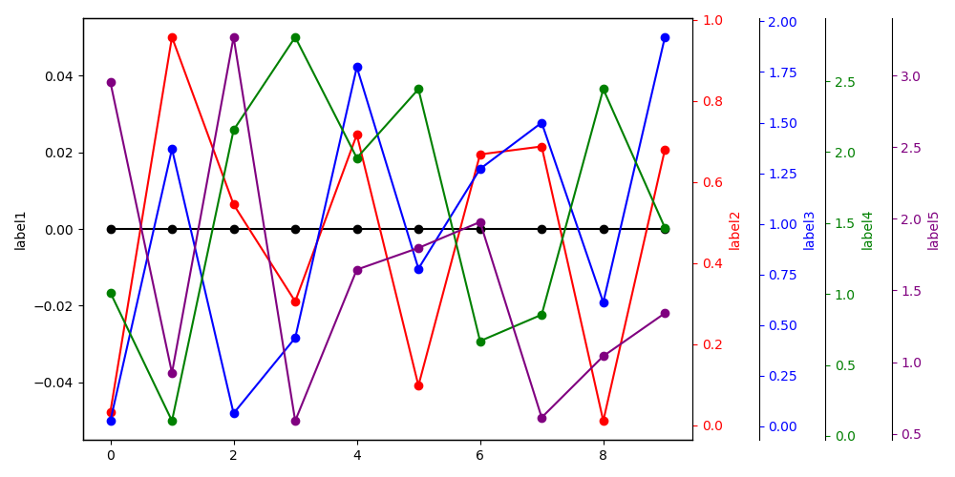
Multiple axes

Slide 40
2 tradeoffs
Informativeness vs. readability
Too little information can conceal data.
But too much information can be overwhelming.
Possible solution: hierarchical organization.
Data-centric vs. viewer-centric
Viewers are accustomed to certain types of visualization.
But novel visualization can be truer to data.

Slide 41
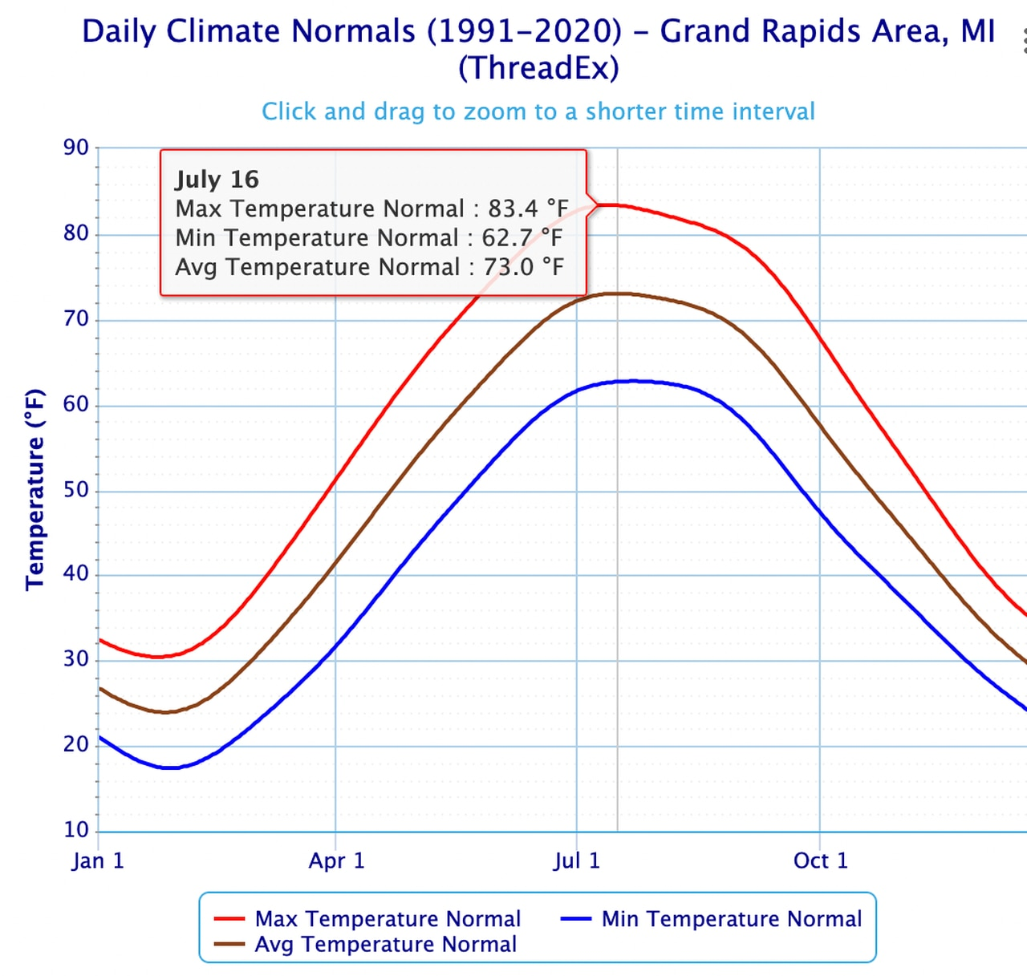
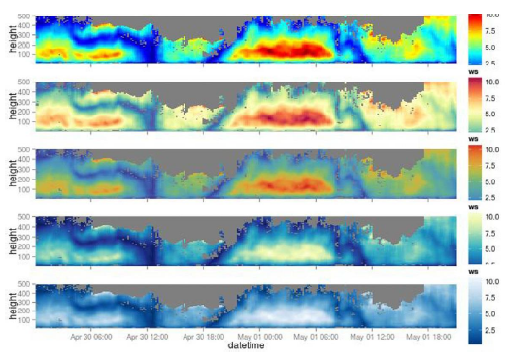
Data visualization traps (1)
Wrong plot types
Be careful with interpretations and keep in mind that the x-axis generally shows the independent variable while the dependent variable is on the y-axis.
Different color usages result in different impressions
Depending on the actual scheme, certain features are highlighted while others fade away. In addition, not all color pallets are b/w compatible.

Slide 42
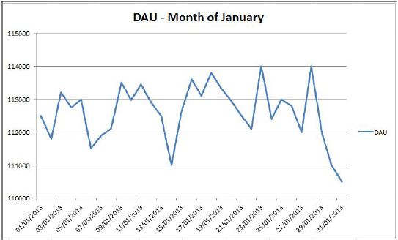
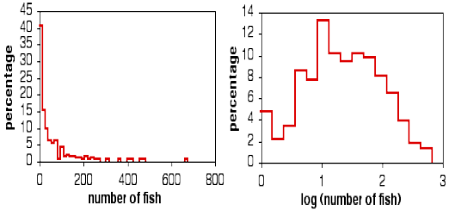
Data visualization traps (2)
Exaggerated plot scale
- The chart displays the evolution of Daily Active Users (DAU) on a timeline. As we can see, the evolution seems to have lots of variations, and the curve also has a worrying decrease at the end of the month.
- Now let's have a glimpse at the y axis. It definitely does not look so frightening.
Take log-scale to show full information

Slide 43
Data visualization traps (3)
Common Errors
No title on graph
Source of data not given
No figure legend
Scales are interrupted
Scales are not labeled
Symbols are not in the same size or equally spaced on graph
Use of 3 dimensional objects to compare data (area/volume)
Scales do not start at zero
Numbers on axis are not equally spaced
Scale is selected to produce desired result

Slide 44
Visualization and dashboard software
Commonly used data visualization software and tools include:
Spreadsheets
Jupyter Notebook and Python libraries
R-Studio and R-Shiny
IBM Cognos Analytics
Tableau
Microsoft Power BI

Slide 45
Spreadsheets
Excel
Provides several chart types – bar charts, line charts, pie charts, pivot charts, scatter charts, trendlines, Gantt charts, Waterfall charts, and combination charts.
Provides recommendations on visual representation.
Can add chart title, change colors of elements, and add labels to data.
Google sheets
Suggest visualization best suited for your data set.
Preferred over Excel for its collaboration features.

Slide 46
Jupyter Notebook and Python libraries (1)
Jupyter Notebook
An open-source web application that provides a great way to explore data and create visualizations.
Matplotlib
Widely used Python data visualization library.
Provides different kinds of 2D and 3D plots and the flexibility to create plots in several different ways.
Helps create high-quality interactive graphs and plots with just a few lines of code.

Slide 47

Jupyter Notebook and Python libraries (2)
Bokeh
Provides interactive charts and plots.
Delivers high-performance interactivity over large of streaming datasets.
Offers flexibility for applying interaction, layouts, and different styling options to visualization.
Can transform visualizations written in other Python libraries, such as Matplotlib, Seaborn, and ggplot.

Slide 48

Jupyter Notebook and Python libraries (3)
Plotly Dash
A Python framework for creating interactive web-based visualizations.
Helps build highly interactive web interactive web applications using Python code.
Does not require knowledge of HTML and JavaScript.
Is easily maintainable, cross-platform, and mobile-ready.

Slide 49

R-Studio and R-Shiny
R-Studio
Can create basic visualization such as histograms, bar charts, line charts, box plot, and scatter plots.
Advanced visualizations such as heat maps, mosaic maps, 3D graphs, and correlograms.
R-Shiny
Shiny is an R package that helps build interactive web apps that can be hosted as standalone apps on a webpage.
You can also build dashboards using Shiny.

Slide 50
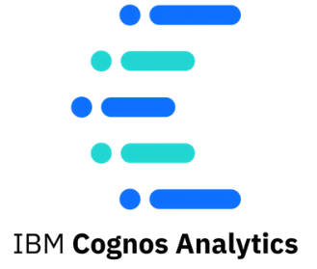
IBM Cognos Analytics
IBM Cognos Analytics – an end-to-end analytics solution
Some of the visualization features provided by Cognos include:
Importing custom visualizations.
A forecasting feature that provides time-series data modeling and forecasts.
Recommendation for visualizations based on your data.
Conditional formatting which allows you to see the distribution of your data and highlight exceptional data points.
Cognos is known for its superior visualizations and overlaying data on the physical world using its geospatial capabilities.

Slide 51

Tableau
Tableau – a software company that produces interactive data visualization products.
Tableau products allow you to:
Create interactive graphs and charts in the form of dashboards and worksheets, with drag and drop gestures.
Publish results in the form of stories.
Import R and Python scripts.
Compatible with Excel files, Text files, Relational databases, Cloud database sources such as Google Analytics and Amazon Redshift.

Slide 52

Power BI
Power BI – a cloud based business analytics service from Microsoft that enables you to create reports and dashboards.
A powerful and flexible tool known for its speed and efficiency.
Has a drag and drop interface.
Is compatible with multiple sources, including Excel, SQL Server, and cloud-based data repositories.
Provides the ability to collaborate and share dashboards and reports securely.

Slide 53
Thanks for your attention!

Slide 54
Appendix 1.http://vis.csail.mit.edu/classes/6.859/ 2. https://www.coursera.org/learn/introduction-to-data-analytics/lecture/z4tlk/introduction-to-visualization-and-dashboarding-software

